Slide 1
Welcome to the Angstrom-Grissom Power Improvements Project virtual town hall. We will begin our presentation at 6:35. Thank you for your patience.

Slide 2
Angstrom-Grissom Power Improvements Project

Slide 3
Angstrom-Grissom Power Improvements Project
Notes
This meeting will be recorded
All attendee audio will be muted upon entry
If you have joined online, please leave questions and comments in the chat feature through WebEx
Dial-in participants will be unmuted for the Q&A session following the presentation

Slide 4
Angstrom-Grissom Power Improvements Project
Agenda
Overview of the Angstrom-Grissom Power Improvements Project
Overview of the Public Utility Commission of Texas project approval process
Question and answer session with AEP Texas project team members

Slide 5
Angstrom-Grissom Power Improvements Project
For questions specific to your property, please visit AEPTexas.com/Angstrom-Grissom
and choose the “Contact Us” link.

Slide 6
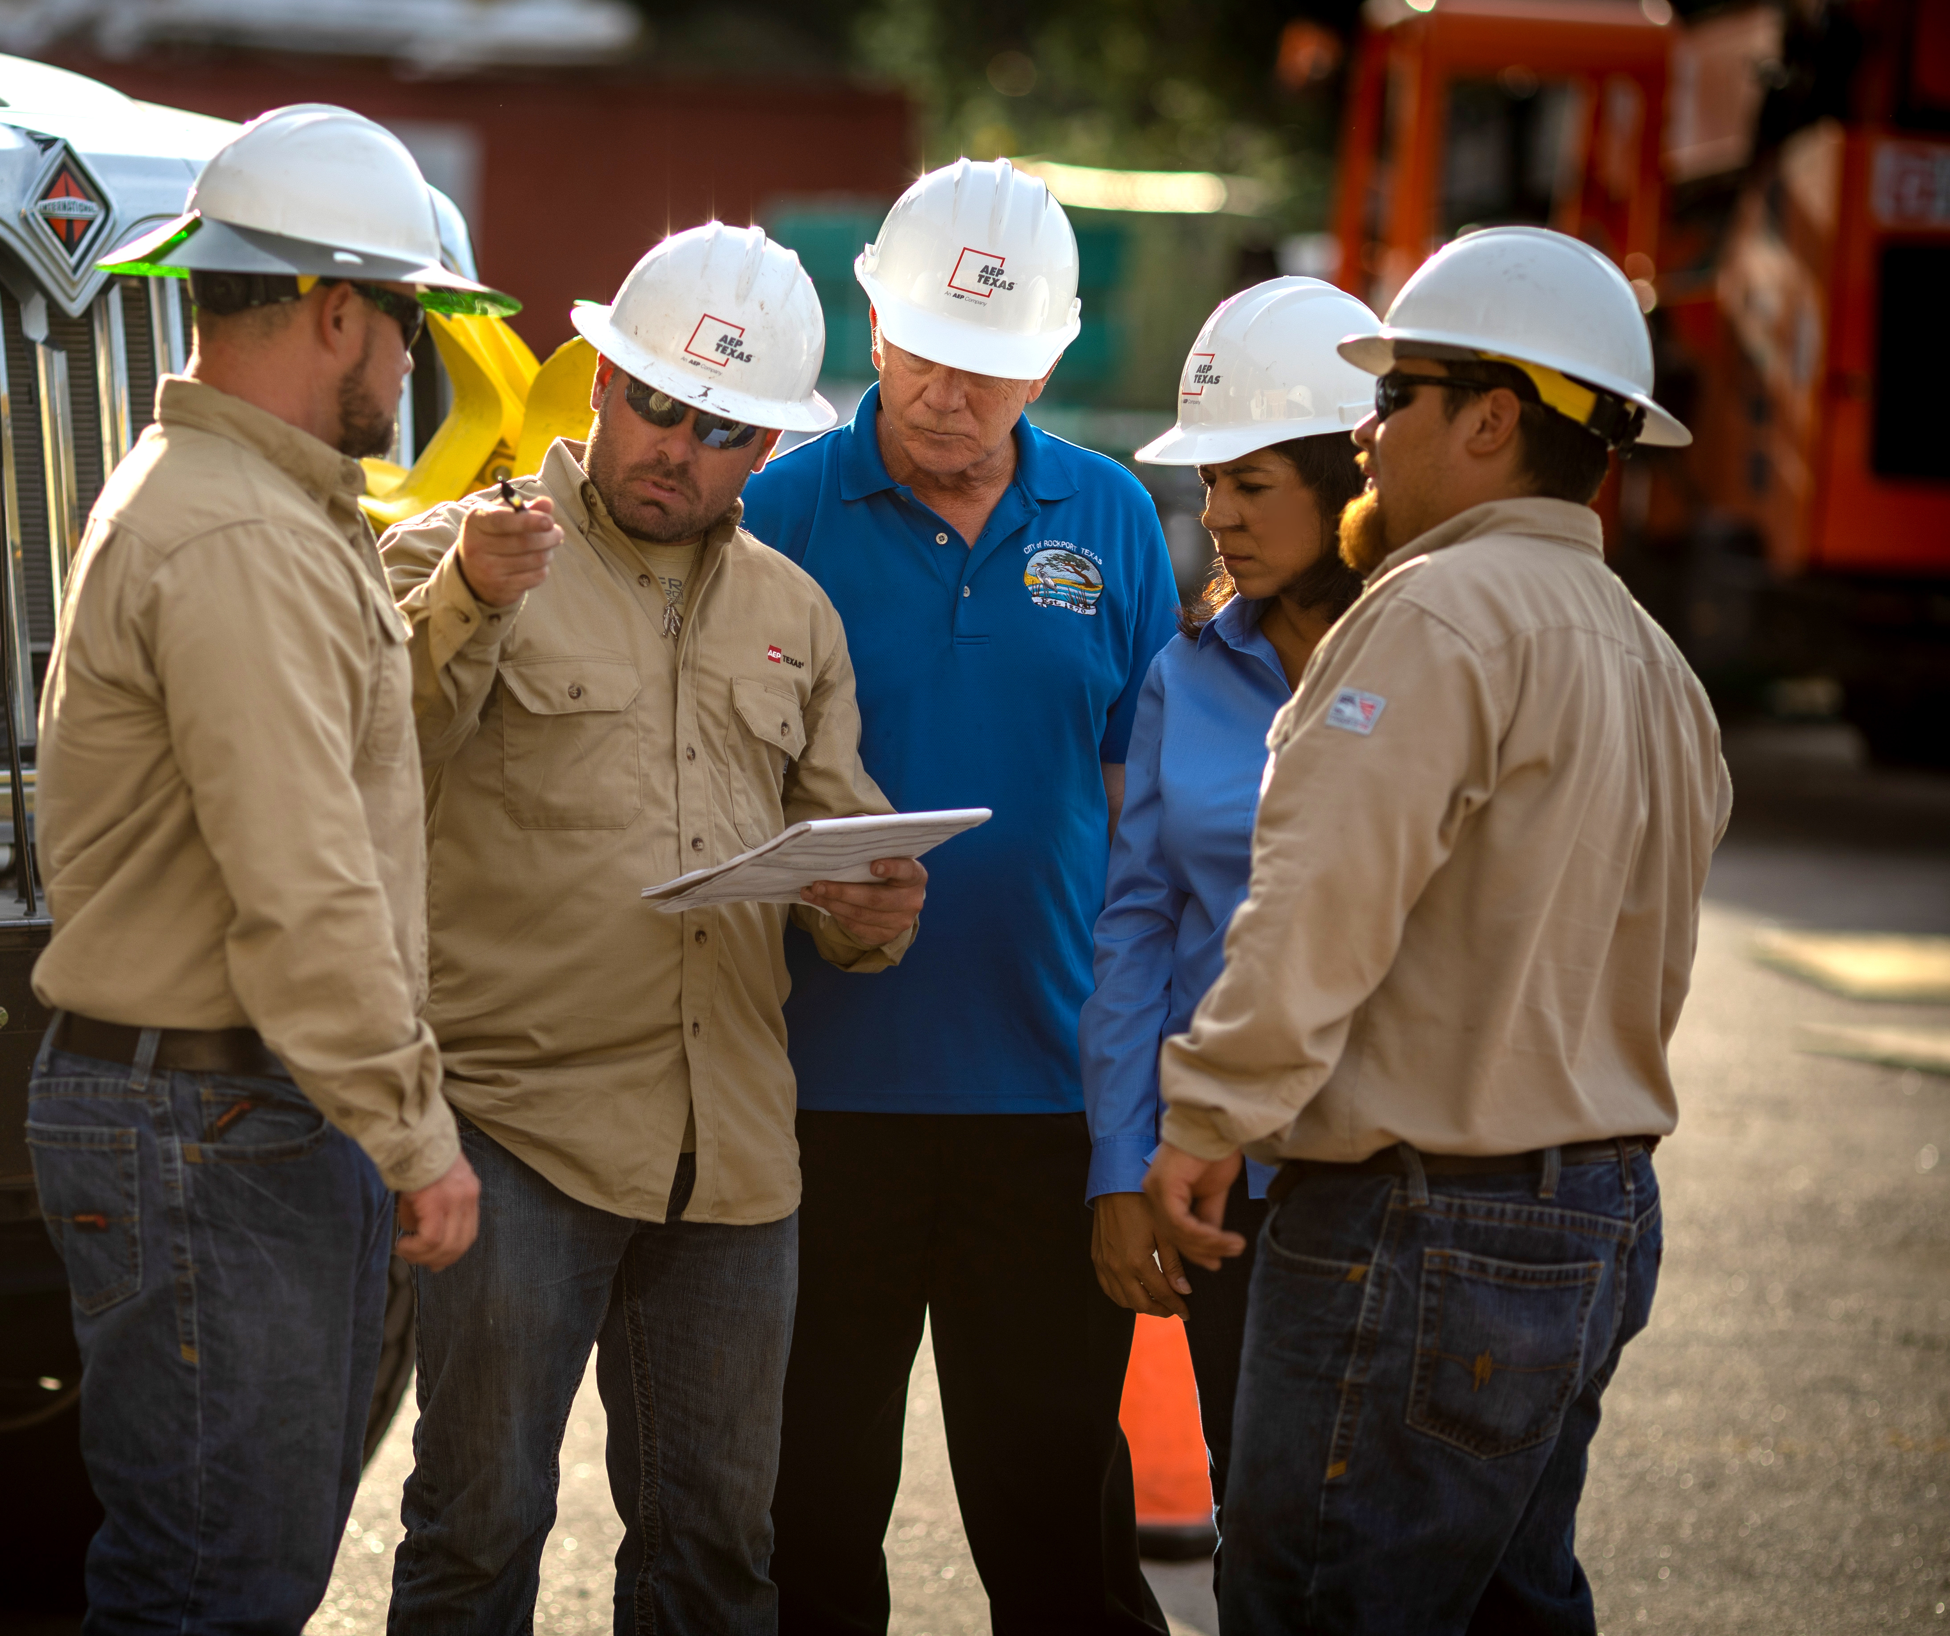
Angstrom-Grissom Power Improvements Project
Teresa Trotman – Project Manager
Dan Lyons & Doug Lee – Project Planning
Randy Roper & Mel Eckhoff – Regulatory
JC Garvin & Nancy Fulk – Engineering
Phillip Castillo & Velma Starr – Right-of-Way
Kensley Greuter & Stacy Santos – Siting
Ben Bowers – Environmental
Juliet Capeheart – Moderator
Michael Harris – Project Outreach

Slide 7
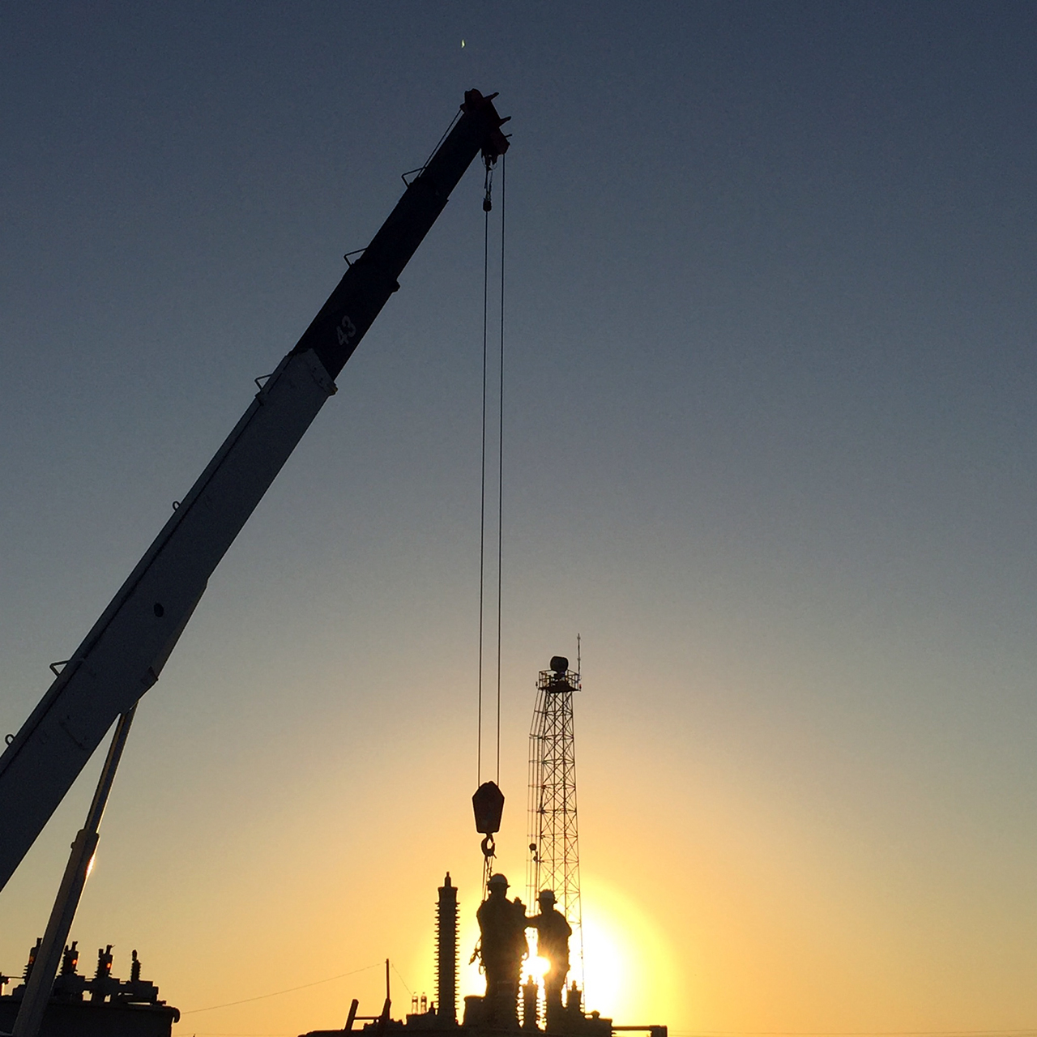
Angstrom-Grissom Power Improvements Project
WHAT
The project involves building approximately 17 miles of 345-kilovolt transmission line to support industrial grown in the Sinton region.
WHERE
The proposed transmission line would begin at the new Angstrom Station, located approximately 4 miles east of Sinton on Texas Highway 188, and end at the Grissom Station, located about 8 miles east of Skidmore.

Slide 8
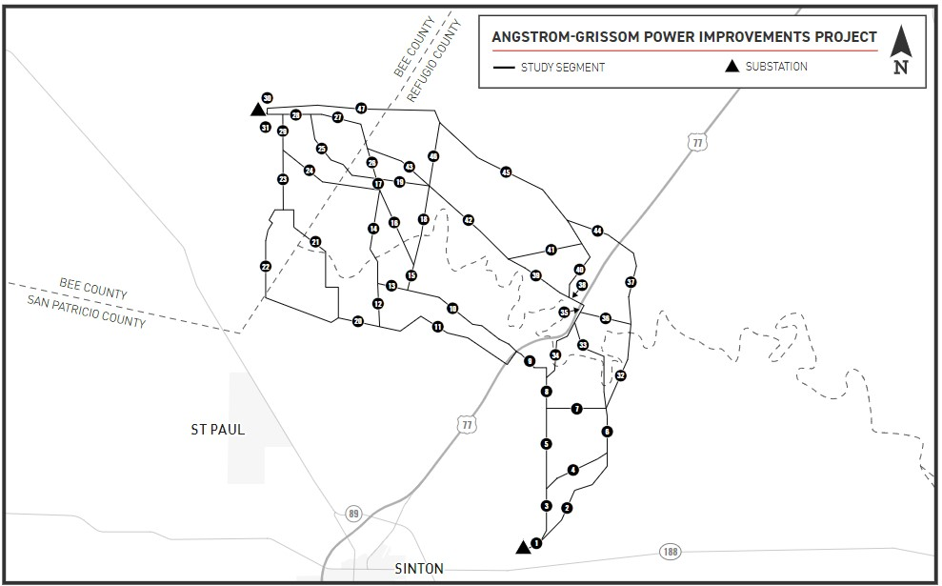
Angstrom-Grissom Power Improvements Project
Grissom Station
Angstrom Station

Slide 9
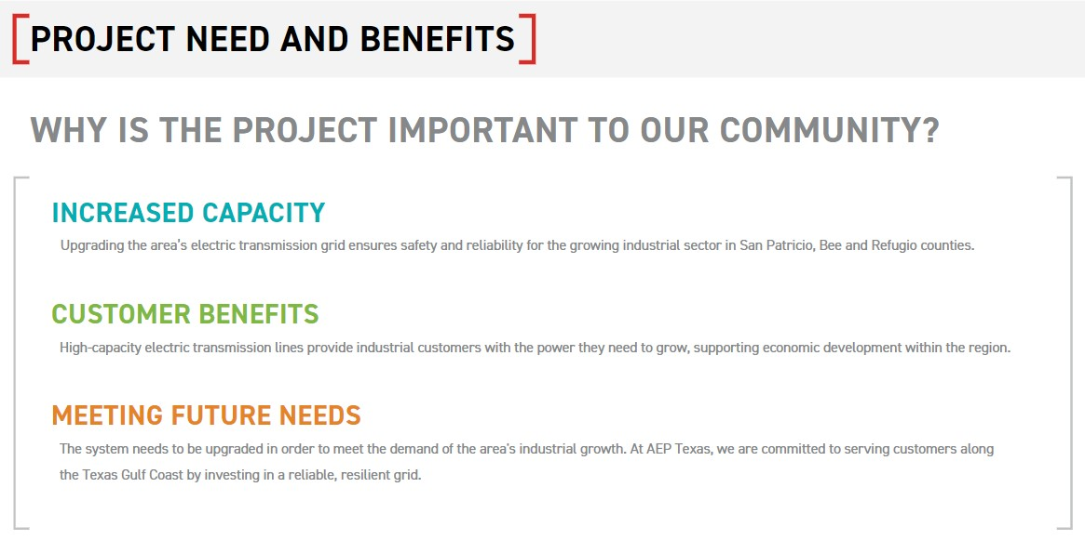
Angstrom-Grissom Power Improvements Project

Slide 10
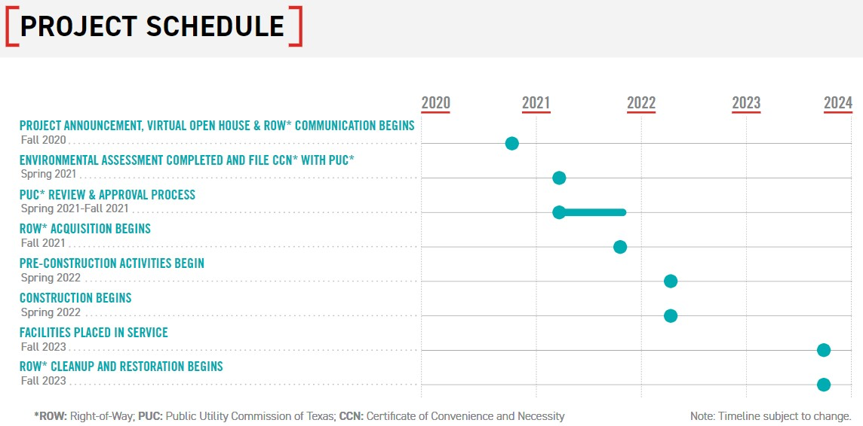
Angstrom-Grissom Power Improvements Project

Slide 11
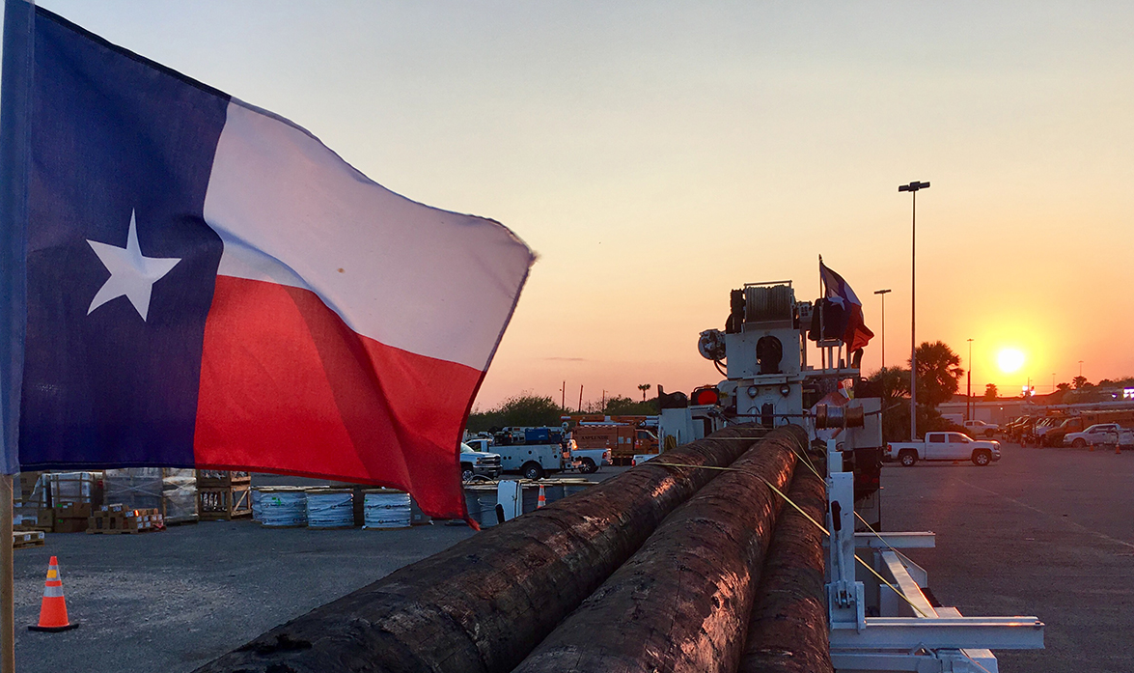
Angstrom-Grissom Power Improvements Project
Structure Information
Structures will use one of three designs:
BOLD (Breakthrough Overhead Line Design) Steel Lattice; or
BOLD Steel Monopole; or
Traditional Steel Monopole
BOLD structures use a more compact configuration that make them shorter than traditional single-steel pole structures.
AEP Texas would like landowners to let us know their preference as we continue the design process.

Slide 12
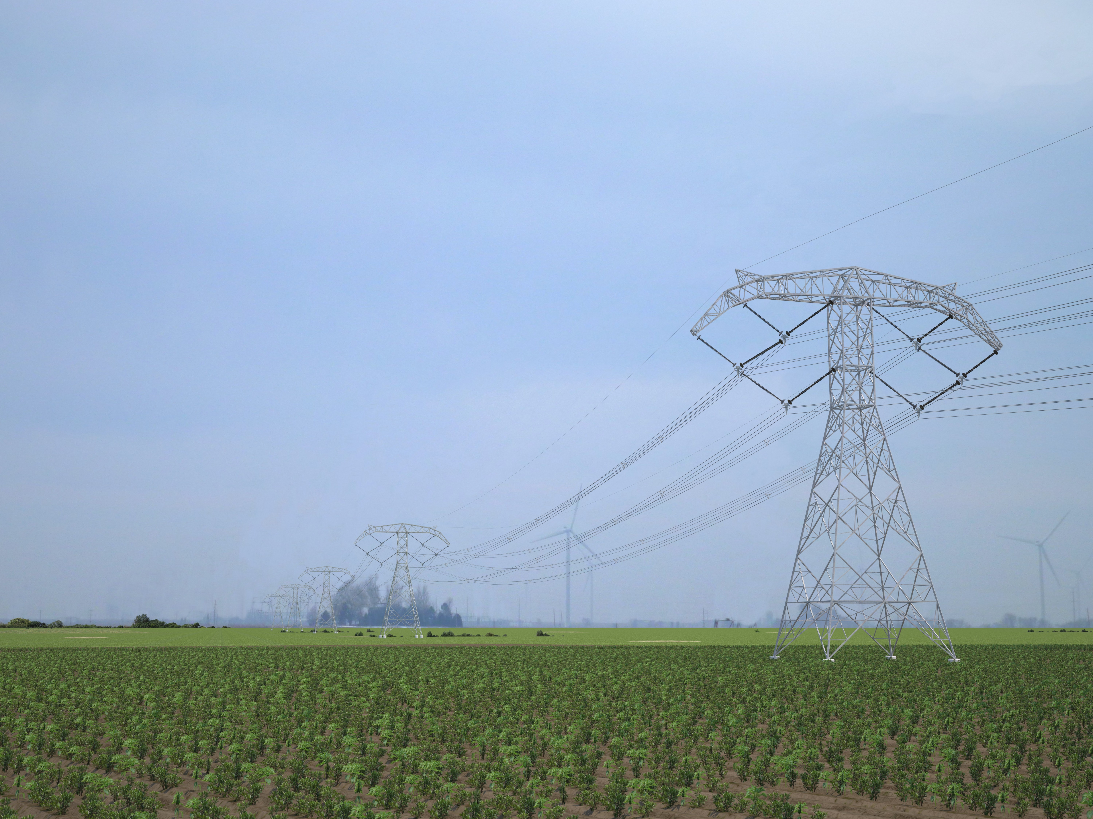
BOLD Steel Lattice Structure Type A
Typical Height: 130 feet
Typical Distance Between Structures: 1,250 feet
Material: Steel
Typical Right-of-Way Width: 150 feet
* Exact structure, height and right-of-way requirements may vary

Slide 13
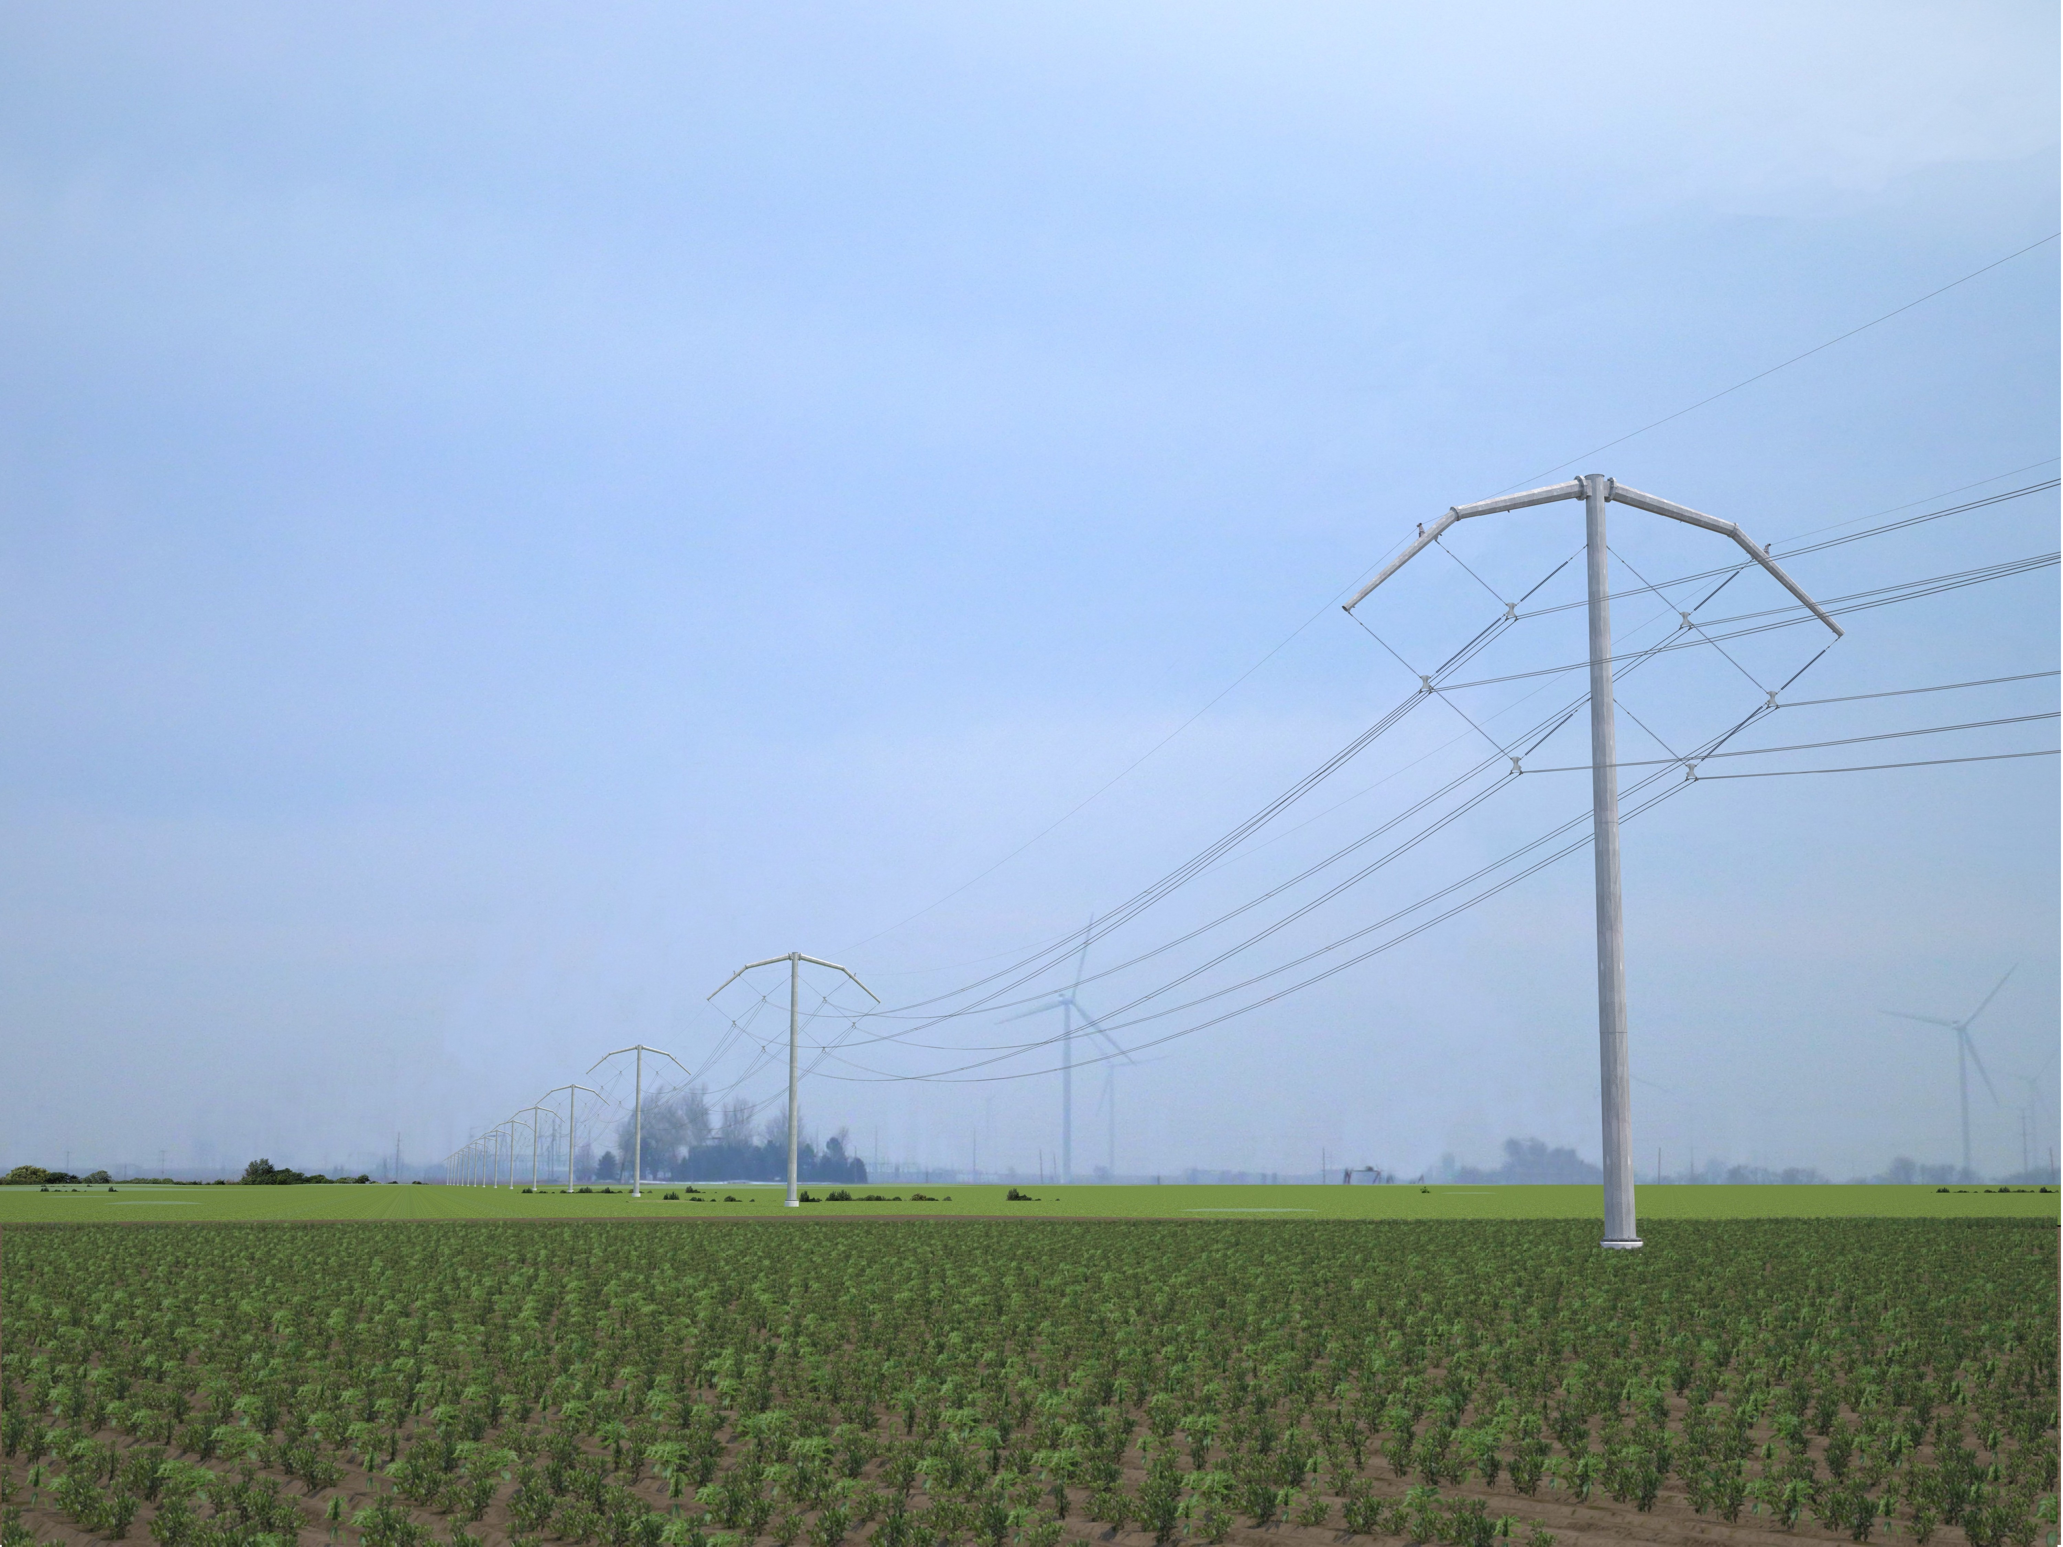
BOLD Steel Monopole Structure Type B
Typical Height: 115 feet
Typical Distance Between Structures: 1,000 feet
Material: Steel
Typical Right-of-Way Width: 150 feet
* Exact structure, height and right-of-way requirements may vary

Slide 14
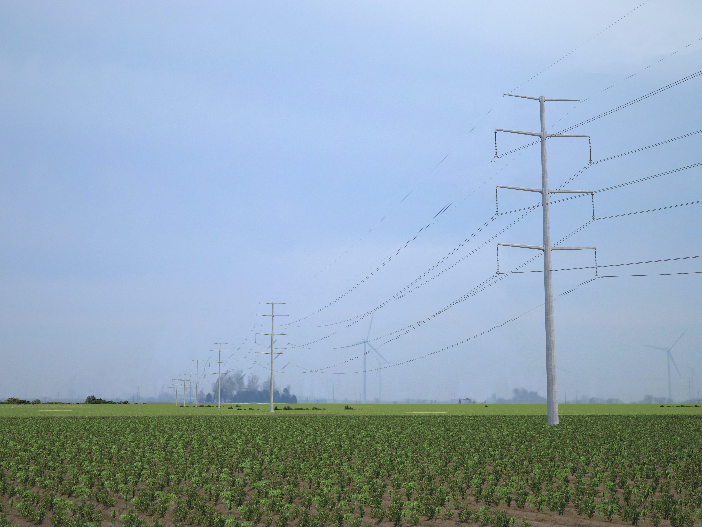
Traditional Steel Monopole Structure Type C
Typical Height: 155 feet
Typical Distance Between Structures: 1,000 feet
Material: Steel
Typical Right-of-Way Width: 150 feet
* Exact structure, height and right-of-way requirements may vary

Slide 15
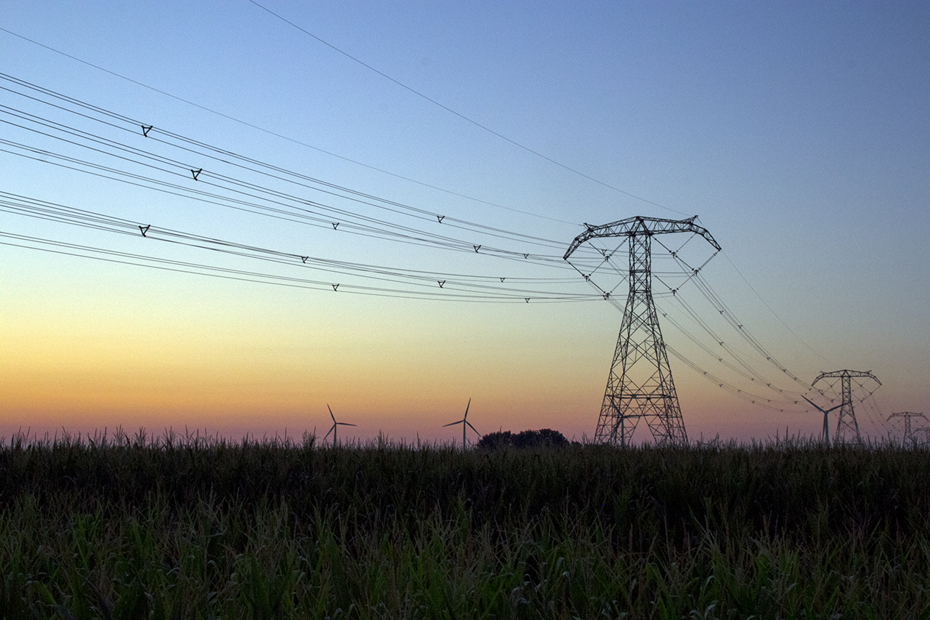
Angstrom-Grissom Power Improvements Project
Public Utility Commission Approval Process
AEP Texas identifies a study area and performs initial evaluations. This information is used to create “preliminary routing links”
AEP Texas presents this information to the public and gather feedback
This feedback is used to refine the routing links and create several power line route options
These options are submitted to the Public Utility Commission of Texas
The PUC evaluates AEP Texas’ application and holds public hearings
The PUC has 180 days to approve or deny AEP Texas’ application.
The PUC determines the final line route if the application is approved.

Slide 16
Angstrom-Grissom Power Improvements Project
We Want Your Feedback
Your comments are critical as we plan this project
You can provide your feedback by:
Returning the comments form included in AEP’s recent mailing
Using the “Contact Us” link at AEPTexas.com/Angstrom-Grissom
Calling (844) 629-4296
Please provide your feedback by Thursday, Dec. 3, 2020

Slide 17
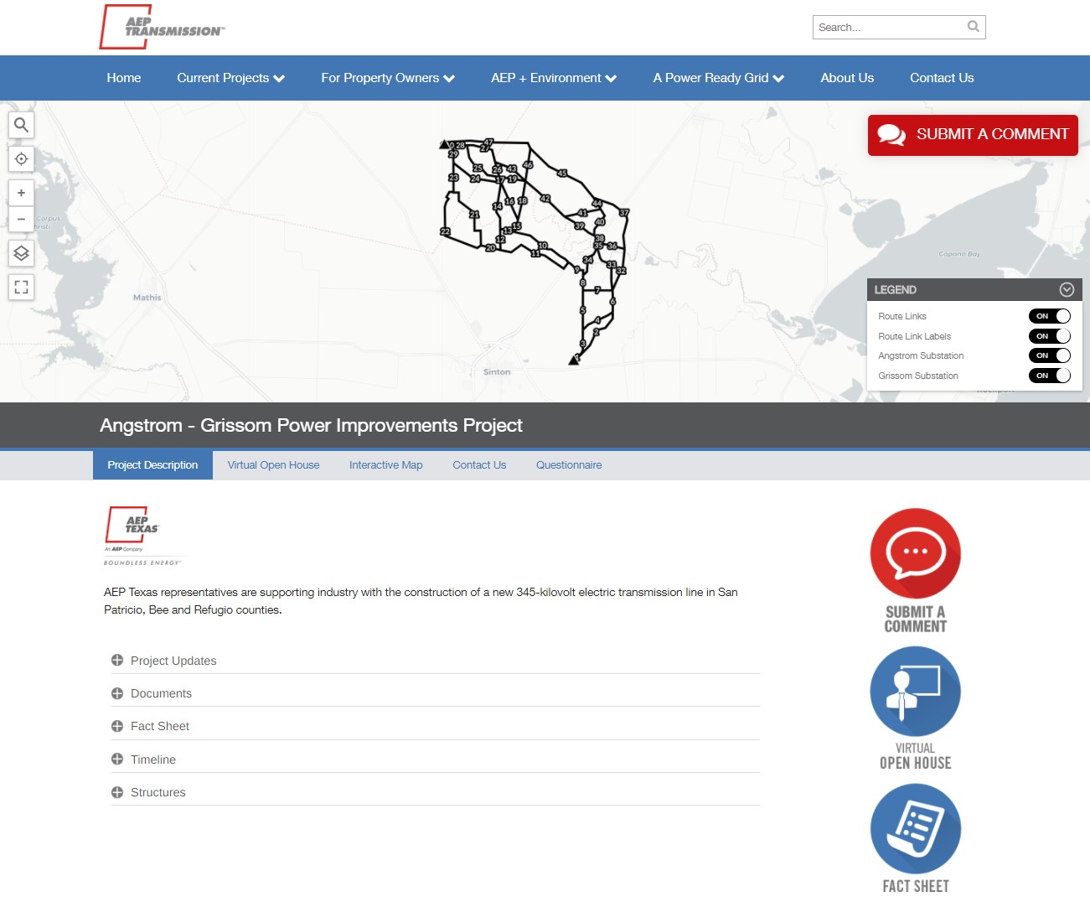

Slide 18
Angstrom-Grissom Power Improvements Project
Questions?
If using a browser, please ask your questions using the Webex chat function
If using a phone, please leave yourself muted until you are asking a question
To discuss specific landowners issues, use the “Contact Us” link

Slide 19
Angstrom-Grissom Power Improvements Project
Teresa Trotman – Project Manager
Dan Lyons & Doug Lee – Project Planning
Randy Roper & Mel Eckhoff – Regulatory
JC Garvin & Nancy Fulk – Engineering
Phillip Castillo & Velma Starr – Right-of-Way
Kensley Greuter & Stacy Santos – Siting
Ben Bowers – Environmental
Juliet Capeheart – Moderator
Michael Harris – Project Outreach

Slide 20
For additional information, visit AEPTexas.com/Angstrom-Grissom
Angstrom-Grissom Power Improvements Project
Thank You!
Michael Harris
Project Outreach Specialist
mhharris@aep.com
(918) 599-2553

